Slide 1
Introduction to Alpaca and MCUT
Alpaca: A lovely parallel and concurrency analyzer MCUT: Microsoft Concurrency Unit Testing Framework

Slide 2
Unit Testing
What is a Unit Test?

Slide 3
Create an Alpaca/MCUT Project
Open Visual Studio 2010
Create a new C# Class Library project
Example name: AlpacaProject
Add a project reference to MCUT Framework:
Microsoft.Concurrency.UnitTestingFramework
This is installed with Alpaca and should be visible in the Add Reference dialog box in VS

Slide 4
Create a test class
A test class is just any class that contains test methods
Requirements:
Public
Non-static
Public, empty constructor
In C#, if no explicit constructor is specified, an empty ctor is automatically generated for the class.

Slide 5
Create your first Unit Test
Import the namespace: using Microsoft.Concurrency.TestTools.UnitTesting;
Create a test method
Requirements: public, non-static
Return value is ignored
For this example, don’t use any arguments
Mark the method as a unit test: [UnitTestMethod]
Add test code body

Slide 6
Hello World Test Code
using System; using System.Collections.Generic; using System.Linq; using System.Text; using Microsoft.Concurrency.TestTools.UnitTesting; namespace AlpacaProject1 { public class Class1 { [UnitTestMethod] public void HelloWorldTest() { Console.WriteLine("Hello world!"); Console.Error.WriteLine("Oops, this is an error."); } } }

Slide 7
Build

Slide 8
Prepare to use Alpaca
Why?
Alpaca creates separate task folders for each test run it performs
Can clutter up the folder alpaca is running in
To Prepare:
Create a temporary folder. E.g. alpaca.tmp
Run alpaca from this folder

Slide 9
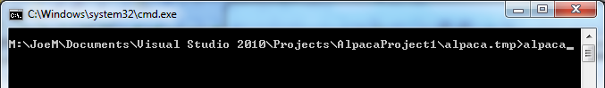
Open Alpaca
Open a command prompt and CD into your temporary folder
Alternate method (Win 7)
Shift+right-click on/in your temporary folder
Click “Open command window here”
Open alpaca by typing alpaca

Slide 10
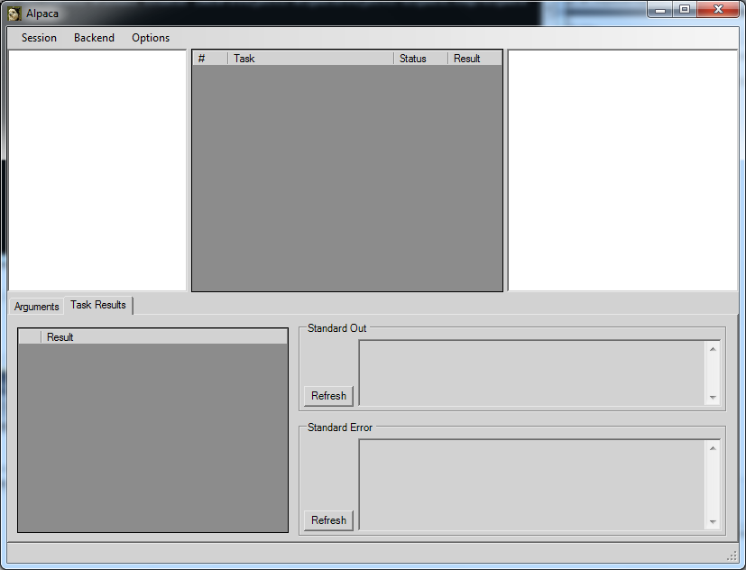
The Alpaca Interface
Test Explorer Tree
Task List
Test Result Messages
Entity xml, Task arguments, Test Case xml
Standard Output
Chess Test Results
Standard Error

Slide 11
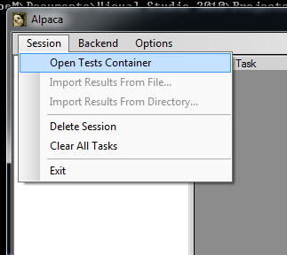
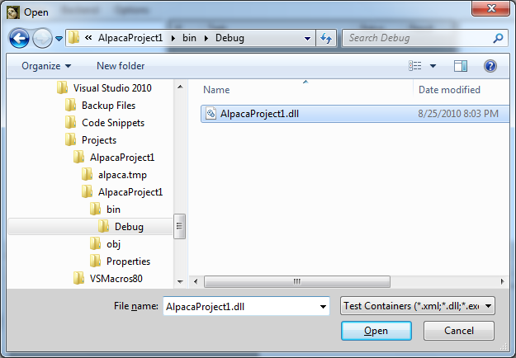
Open Test Assembly
Session -> Open Tests Container
Navigate to the dll that you built for your alpaca project
Note: If you don’t see your assembly make sure it’s been built first.

Slide 12
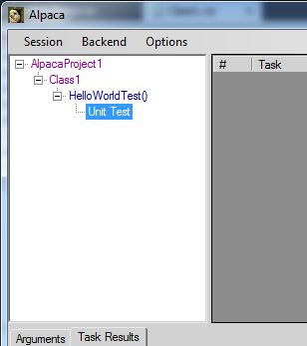
Test Assembly Tree
Test Assembly Container
Test Class Name
Test Method
Test Type(s)
There may be more than one type of test specified for a test method

Slide 13
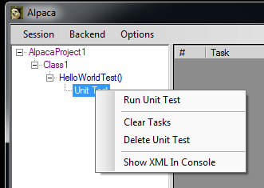
Run a Test
Right-click on the test method or the “Unit Test” test type node
Select the “Run” or “Run Unit Test” menu option
A task will be created in the tasks list.

Slide 14
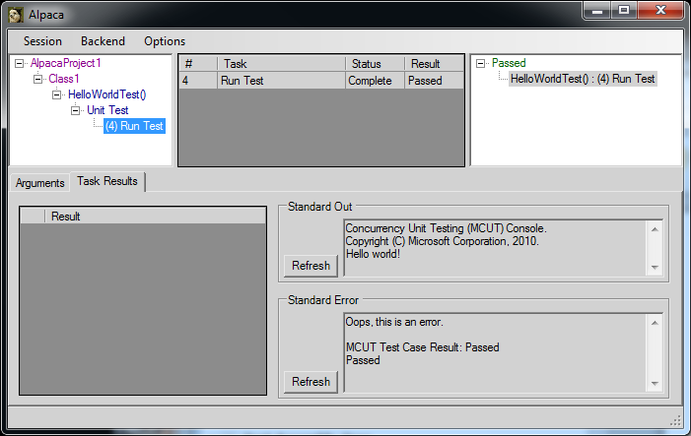
Test Results and Output
Test runs added as children
Categorized by result type
One task per test case run

Slide 15
Test Assertions
Assert class
Static class containing methods that will assert conditions.
Examples
Assert.IsTrue(a != null); Assert.IsNull(a); Assert.AreEqual(10, n);
When an assertion fails, an exception is thrown and Alpaca is notified

Slide 16
SortArrayTest
[UnitTestMethod] public void SortArrayTest() { int n = 1000; Random rand = new Random(); // Create array of random integers int[] a = new int[n]; for (int i = 0; i < n; i++) a[i] = rand.Next(); // Sort the array SortArray(a); // Verify Correctness for (int i = 1; i < n; i++) Assert.IsTrue(a[i] >= a[i - 1] , "Element {0} is not sorted correctly", i); }
private void SortArray(int[] a) { //Array.Sort(a); }

Slide 17
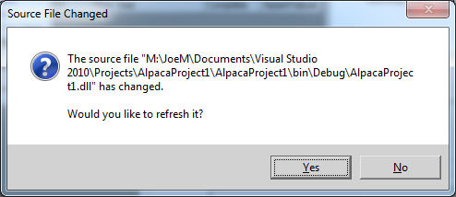
Refresh Assembly
After adding the new test method, rebuild and switch over to Alpaca
Alpaca watches your test assembly for changes
To disable the notification:
Options -> Uncheck “Confirm Auto Refresh”

Slide 18
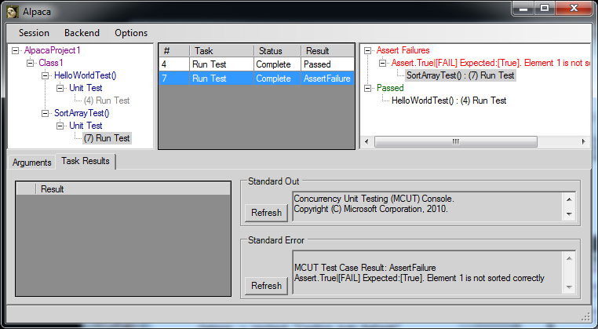
Run Failing Test
Run the SortArrayTest

Slide 19
View Exception Stack Trace
Currently, no way to debug into a unit test in VS from Alpaca ☹
But we can see the exception with it’s stack trace:
Click/select on the result node in the results tree
View the “Arguments” tab to see the xml
Inside the xml is an error element that tells you the exceptionType and stackTrace

Slide 20
Fix the Bug
Uncomment the SortArray function’s body
private void SortArray(int[] a) { Array.Sort(a); }
Rebuild
Rerun the test
Test passes

Slide 21
Performance Tests
Measure time taken to perform a certain block of code
Intervals displayed in a graph
TaskMeter
Provides Start/Stop methods for specifying the block of code to time

Slide 22
Create a Performance Test
Create TaskMeter instance(s) TaskMeter initMeter = new TaskMeter("Initialize Data"); TaskMeter sortingMeter = new TaskMeter("Sort"); TaskMeter verificationMeter = new TaskMeter("Verify");
Mark our SortArrayTest method to also be a Performance test: [PerformanceTestMethod]
Add meter Start/Stop calls around blocks of code you wish to time

Slide 23
SortArrayTest
TaskMeter initMeter = new TaskMeter("Initialize Data"); TaskMeter sortingMeter = new TaskMeter("Sort"); TaskMeter verificationMeter = new TaskMeter("Verify"); [UnitTestMethod] [PerformanceTestMethod] public void SortArrayTest() { int n = 1000; Random rand = new Random(); // Create array of random integers initMeter.Start(); int[] a = new int[n]; for (int i = 0; i < n; i++) a[i] = rand.Next(); initMeter.End(); // Sort the array sortingMeter.Start(); SortArray(a); sortingMeter.End();
// Verify Correctness verificationMeter.Start(); try { for (int i = 1; i < n; i++) Assert.IsTrue(a[i] >= a[i - 1] , "Element {0} is not sorted correctly", i); } finally { verificationMeter.End(); } }

Slide 24
Run Performance Test Interactively
In Alpaca, you will now see another node under the SortArrayTest() node called “Performance Test”
Right-click and click “Run Performance Test Interactively”
In the window that gets displayed, click the Go button.

Slide 25
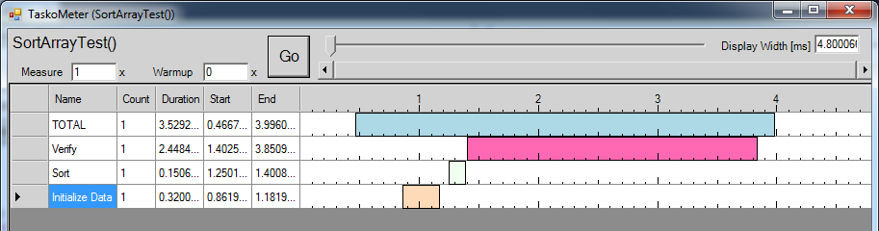
TaskoMeter
# Repetitions to execute the test method
# Repetitions w/o timings (done first)
Zoom Bar
Interval between a Start and Stop relative to other meters
One row per task meter

Slide 26
Repetitions and Warmups
You can specify…
Default # of time to run the test w/o timing
Has the effect of warming up the cache etc.
Default # of times to repeat the test and take timings
[PerformanceTestMethod(Repetitions=5, WarmupRepetitions=2)] public void SortArrayTest() …

Slide 27
Note about TaskoMeter
When TaskoMeter runs, it loads the test assembly (and any of its dependencies) into memory. So while it’s open the OS keeps it from being modified.
Therefore, you will not be able to rebuild those assemblies unless the TaskoMeter window that has it open has been closed
When Alpaca launches a performance test, it does so by launching a new process for every test
This helps prevent Alpaca from loading the assembly in its own app domain so you won’t have to close Alpaca to rebuild an assembly, just the TaskoMeter windows

Slide 28
Test Arguments
Run a test with a fixed set of arguments
Specify using: [TestArgs(…)]
Number of values must match number of parameters for the method
Can declare more than one instance of the attribute; each represents the arguments for a single run of the test.
[TestArgs(100)] [TestArgs(1000)] public void SortArrayTest(int n) { Random rand = new Random(); …

Slide 29
TestArgs Limitations
Only values that the complier can create at compile-time may be used
Must be able to be converted to a string and then back to the parameter’s type

Slide 30
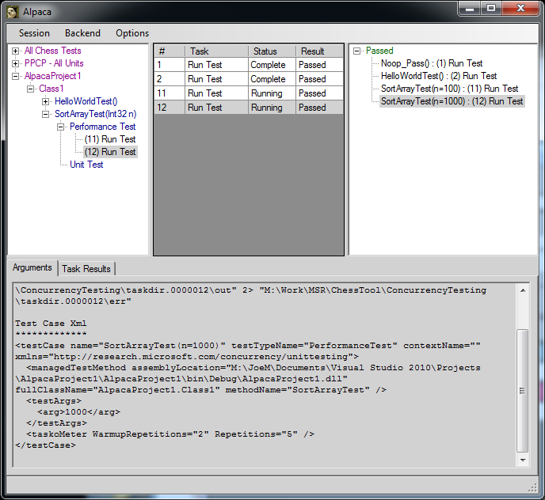
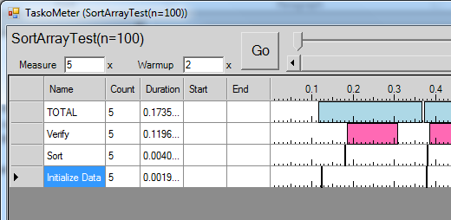
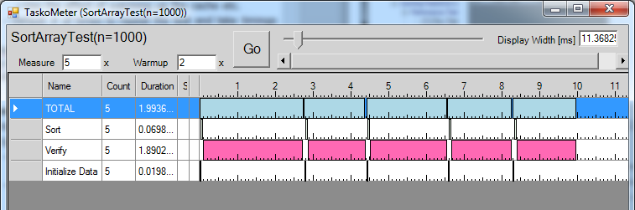
TestArgs
One test run per TestArgs specified
Arg value displayed
Test run for 5 repetitions
See args specified in the test case’s xml

Slide 31
Concurrency Unit Testing
Different from regular unit testing
Want to expose concurrency bugs
May use various tools to analyze or instrument code to reason about correctness
Often must be a limited set of execution code to speed up tests
The nature of concurrency testing is different enough from normal unit testing that one generally doesn’t mark a test method as a unit test and a concurrency unit test method

Slide 32
Preemption Scheduling
Preemption:
The interruption of a running task with the intent to execute another task and return to the interrupted task at a later time.
By controlling the scheduling of preemptions you can explore all possible schedules
Certain optimizations can also be done to limit the exploration space.
Alpaca uses the MS ChessTool to run schedule and data race tests.

Slide 33
Schedule Tests
Alpaca runs MChess in the background to instrument and explore preemption schedules
Can be used to find common concurrency bugs
Deadlocks

Slide 34
Create a Schedule Test
Create test method that simulates a deadlock
Mark the method as a schedule test using the attribute [ScheduleTestMethod]
Build and refresh assembly in Alpaca
Run the test in Alpaca by right-clicking and selecting “Run Schedule Test”
[ScheduleTestMethod] public void SimpleDeadlock() { object syncObj1 = new object(); object syncObj2 = new object(); Parallel.Invoke( () => { lock (syncObj1) lock (syncObj2) { } }, () => { lock (syncObj2) lock (syncObj1) { } }); }

Slide 35
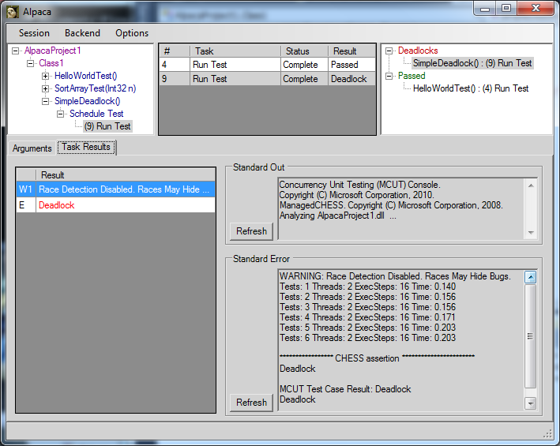
Schedule Test Run
Result = Deadlock
Mchess is used to run the test
Chess results: notifications, warnings, errors are displayed here. MChess can detect multiple errors for a given run.
Chess Error stream:
Displays progress as chess explores schedules.

Slide 36
Finding the Deadlock
Alpaca also exposes features of MChess
Run MChess again with the same schedule that found an error with Tracing to enable more diagnostics
Can view the operations that occurred in the schedule in the code using Concurrency Explorer

Slide 37
Run Deadlocked Schedule with Tracing
In the “Task Results” tab, right click the “E|Deadlock” result item from the Chess Results grid
This is not the same as the one from the task list
Click “Repro Deadlock with Tracing”
Note other options here for debugging ;-)
The test will run with MChess again and return with another Deadlock result. Only this time just the schedule that produced the deadlock will be instrumented.

Slide 38
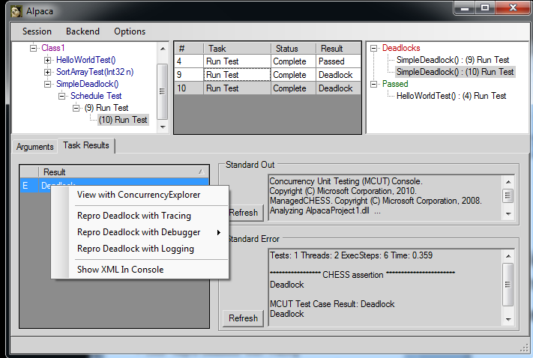
Open Schedule in Concurrency Explorer
Right-click the new E|Deadlock row in the run that had tracing enabled
Select “View in Concurrency Explorer”
Only one schedule was run

Slide 39
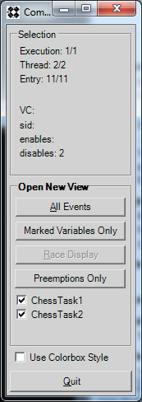
View Deadlock in Concurrency Explorer
When opening the Concurrency Explorer (CE) from a deadlocked schedule it automatically opens the “All Events” window.
By clicking on the orange “Preemption” item you see where the first thread preempts just before obtaining the 2nd lock.
Clicking next on the 2nd thread’s last instruction (text in orange) you see the 2nd thread preempted just before optaining it’s 2nd lock.
Both threads are waiting on the lock for which the other thread has obtained.

Slide 40
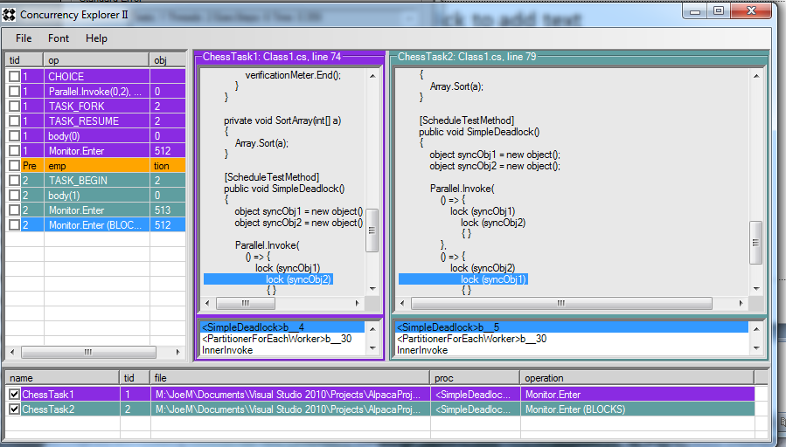
Concurrency Explorer
Clicking the Preemption row -> The line where the preemption occurred is highlighted
Stack trace of last selected event for the thread
Clicking the last event -> The line where the deadlock occurred is highlighted

Slide 41
Fix the Deadlock
Fix the deadlock by swapping the order of lock acquisition for one of the threads.
Run the test again.
The test should now pass.

Slide 42
Data Race Tests
Data Race: When two concurrent threads access the same memory location and one of the accesses is a write
Notice the warning given by Mchess when we ran the previous schedule test: WARNING: Race Detection Disabled. Races May Hide Bugs.
When data race detection is enabled Mchess verifies that preempted threads don’t cause a data race
Same number of schedules explored as a regular Schedule Test

Slide 43
Create a Test With a Data Race
Create a basic data race test where two threads read/write to the same shared variable
Mark the test with the [DataRaceTestMethod] attribute
Run the test in Alpaca
[DataRaceTestMethod] public void SimpleDataRace() { int cnt = 0; Parallel.Invoke( () => cnt++, () => cnt++ ); Assert.AreEqual(2, cnt); }

Slide 44
View The Data Race
Rerun the erroring schedule by right-clicking on [one of] the data race Chess errors and clicking “Repro Race Rx with Tracing”
After this test finishes, right-click the R1 row and click “View Race with Concurrency Explorer”

Slide 45
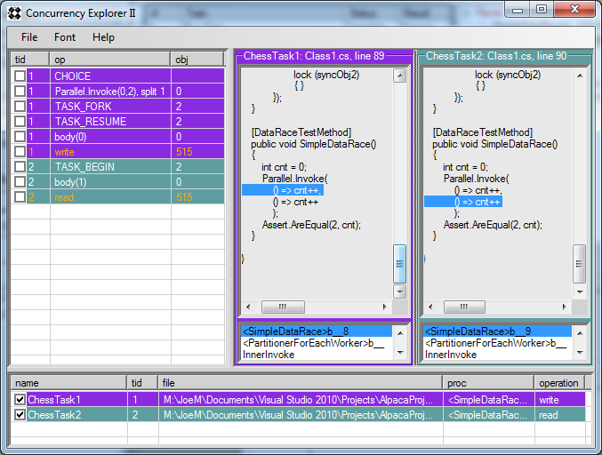
Data Race in Concurrency Explorer
Each color represents a different thread’s operations
Thread 1: Write
Thread 2: Read

Slide 46
Chess Tests
The ScheduleTestMethod and DataRaceTestMethod attributes are just abstractions of the attributes available to create a test that runs using MChess.
Namespace: Microsoft.Concurrency.TestTools.UnitTesting.Chess
There is some documentation already via intellisense in Visual Studio.
Note an MChess test is for managed code only. Thus the attribute is simply ChessTestMethod since the ‘M’ is implied.
We’ll just provide a pretty complex example of an MChess test.

Slide 47
MChess Test Sample
1:[ChessTestMethod()] 2:[ChessTestContext( 3: PreemptAllAccesses = true 4: , ExtraCommandLineArgs = new[]{ 5: "/dpt:AntisocialRobots.RobotSimulationBase" 6: ,"/dpt:AlpacaProject.RobotSimulationFixes" 7: })] 8:public void NaiveParallel_ScheduleTest()
Line 1: Simply marks the method as an MChess test method.
Line 2: Specifies a context under which to run the test. There can be multiple contexts specified for a test. When the test is run, Alpaca executes one run per cross product of context and specified TestArgs (if any). If no name is specified, then it’s the default context. If more than one contexts are specified, they must have unique names.

Slide 48
MChess Test Sample (cont.)
Line 3: This particular test doesn’t make use of any threading/locking primitives and thus there would be no preemptions. By specifying this property, MChess will explore schedules where it will preempt on all memory accesses. The problem with this (as you may guess) is that the number of schedules explored is huge.
Line 4: While the most common options are implemented via attribute properties sometimes you need to specify an option on the command-line yourself. This array of strings (one string per arg) allows you to do just that.
Lines 5-6: The /dp[tmn] command line option tells MChess “Don’t Preempt [Type, Method, Namespace]” This helps to minimize the schedule exploration space for this test so it takes much less time to run.

Slide 49
Other Features
[ExpectedException(typeof(…Exception))]
Asserts that the method throws an exception of the specified type
[ExpectedResult(TestResultType.AssertFailure)]
Indicates that for a test to pass in Alpaca, the test should produce the specified result
E.g. When you expect a test to produce a deadlock but don’t want Alpaca to report one
You can right-click a chess error and Debug that schedule
Allows you to attach a debugger to the process

Slide 50
Regression Testing
Another layer after the ExpectedResult attribute that is only run when regression test assertions are enabled
Allows a test to pass regression testing if the result is any of those specified
Ignored by Alpaca
Enabled for the following mcut command:
>mcut runAllTests [testAssembly]
This runs all tests and prints results to the Console.
/// This test may or may not find the deadlock since we aren't using MChess [UnitTestMethod] [RegressionTestExpectedResult(TestResultType.Passed, TestResultType.DeadLock)]
public void MyLoadTest()

